Slide 1
Enhancing Neural Networks through Evolutionary Algorithms
Project Presentation

Slide 2
Details of students and Supervisor
Names
Aditya Gupta
Naima Farooqi
Saransh Khandelwal
Enrollment
16803004
16803005
16803014
Supervisor: Dr. Parul Aggarwal
Panel: Mr. Gurve Mahendra, Mr. Vimal Kumar

Slide 3
Problem Statement
The point of our undertaking is to improve the viability of the backpropagation Neural network algorithm.
We tested different nature-inspired algorithms hybrid with neural networks.
We studied algorithms like Particle swarm optimization, bat algorithm, fireflies algorithm, ant optimization algorithm, artificial bee colony algorithm, salp algorithm, whale algorithm, harris hawk algorithm, etc.
We proposed two new algorithms 1) Hybrid of Harris hawk with the neural networks and 2) Hybrid of Harris hawk optimization and whale optimization to train the weights of neural networks.

Slide 4
Significance of problem
Backpropagation is a good approach for optimization and is able to train weights of Neural Network and give better results.
But it has some drawbacks
Getting stuck in the local optima of weights
It wants its objective function to be differentiable
.
1
3
The actual performance of backpropagation on a specific problem is dependent on the input data
Backpropagation can be quite sensitive to noisy data
2
4

Slide 5
Thus
We hybridized different evolutionary algorithms (like particle swarm optimization, salp swarm optimization, genetic algorithm, whale optimization and harris hawk optimization) with the neural networks, and also
Hybridized two different evolutionary algorithms (whale optimization and harris hawk optimization) to train weights of neural networks. The two new algorithms which we have proposed are very promising in giving better results

Slide 6
We also present a comparative study of different evolutionary algorithms hybridized with neural networks and compared it to our new proposed algorithm.
The excellence of the proposed algorithm is certified by exercising it on many kinds of datasets of fraud and cancer and these statistical results are compared with the results of rival optimization algorithms.
The procured results demonstrate that our proposed algorithm functions better than other evolutionary methods.

Slide 7
Brief Background Study of
Whale Optimization Algorithm

Slide 8
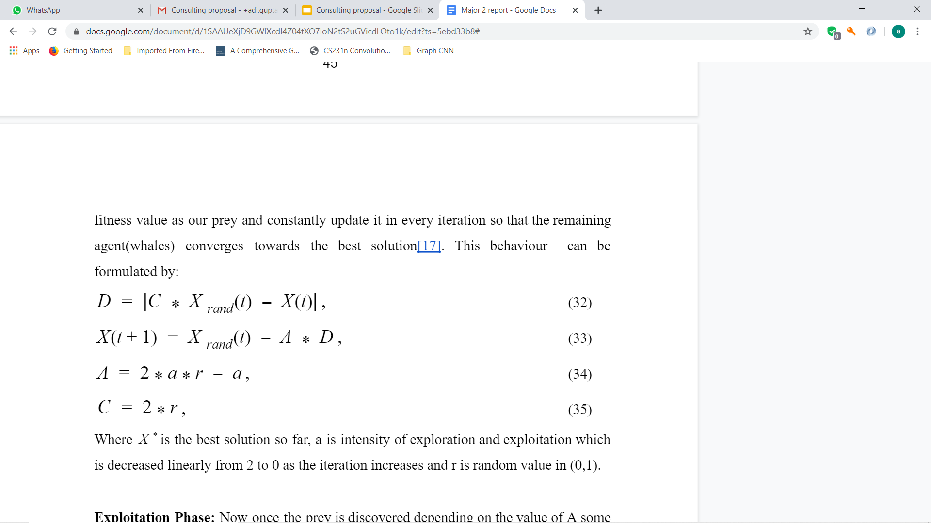
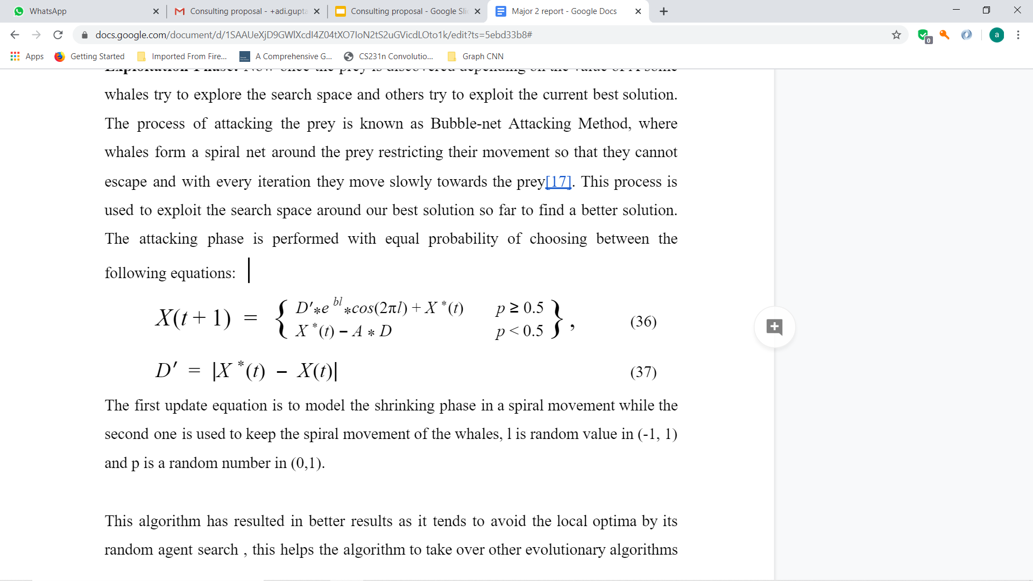
The target of a WOA algorithm is to avoid the local minima and maxima and achieve a good convergence rate towards the best solution.
Exploration Phase:
Exploitation Phase:

Slide 9
Proposed Algorithm 1
Hawk optimization algorithm to train weights of Neural Networks

Slide 10
Significance
We ensemble Harris Hawk Algorithm with our Multi-Layer Feed Forward Network to simulate the behaviour of Harris’s hawk bird, which is famous for its combined behaviour and attacking its prey by pouncing on it from several random directions and trailing the moment of its prey by surprise attacks.
They improvise with each of their attacks following the escaping pattern of their prey. We try to mimic this chasing pattern and surprise attacks into our algorithm to reach the optimized value of weights.

Slide 11
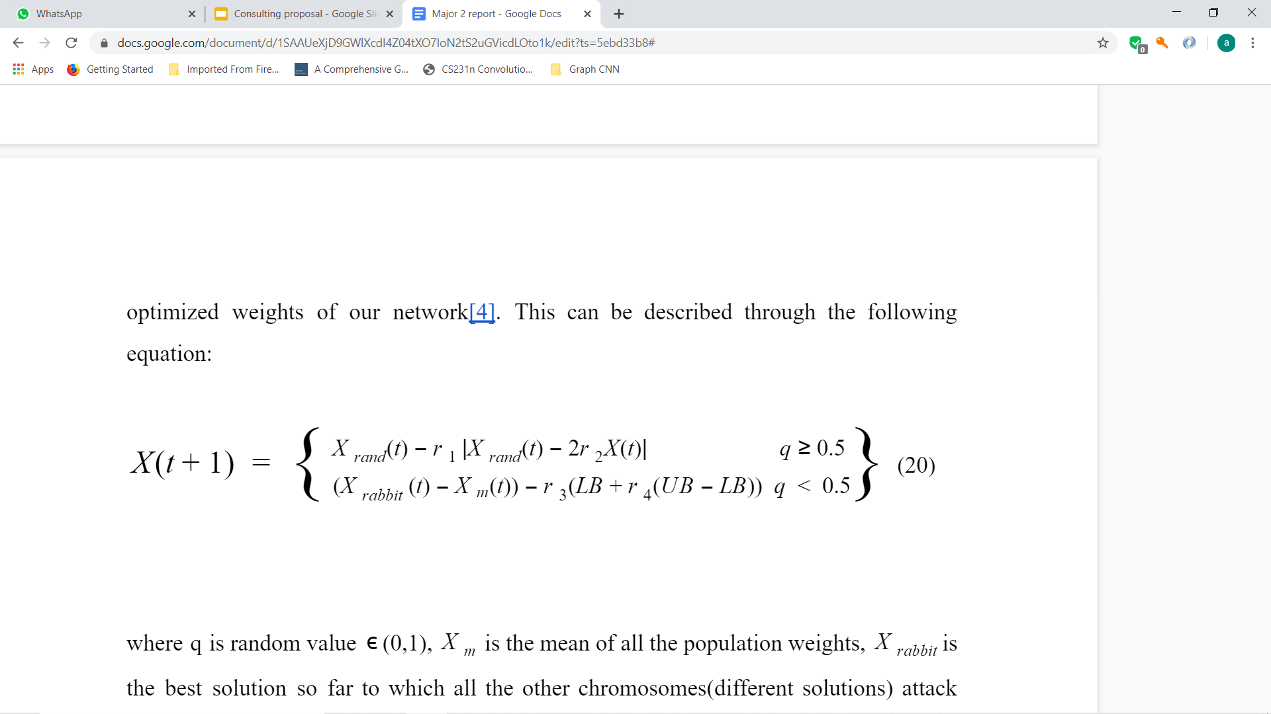
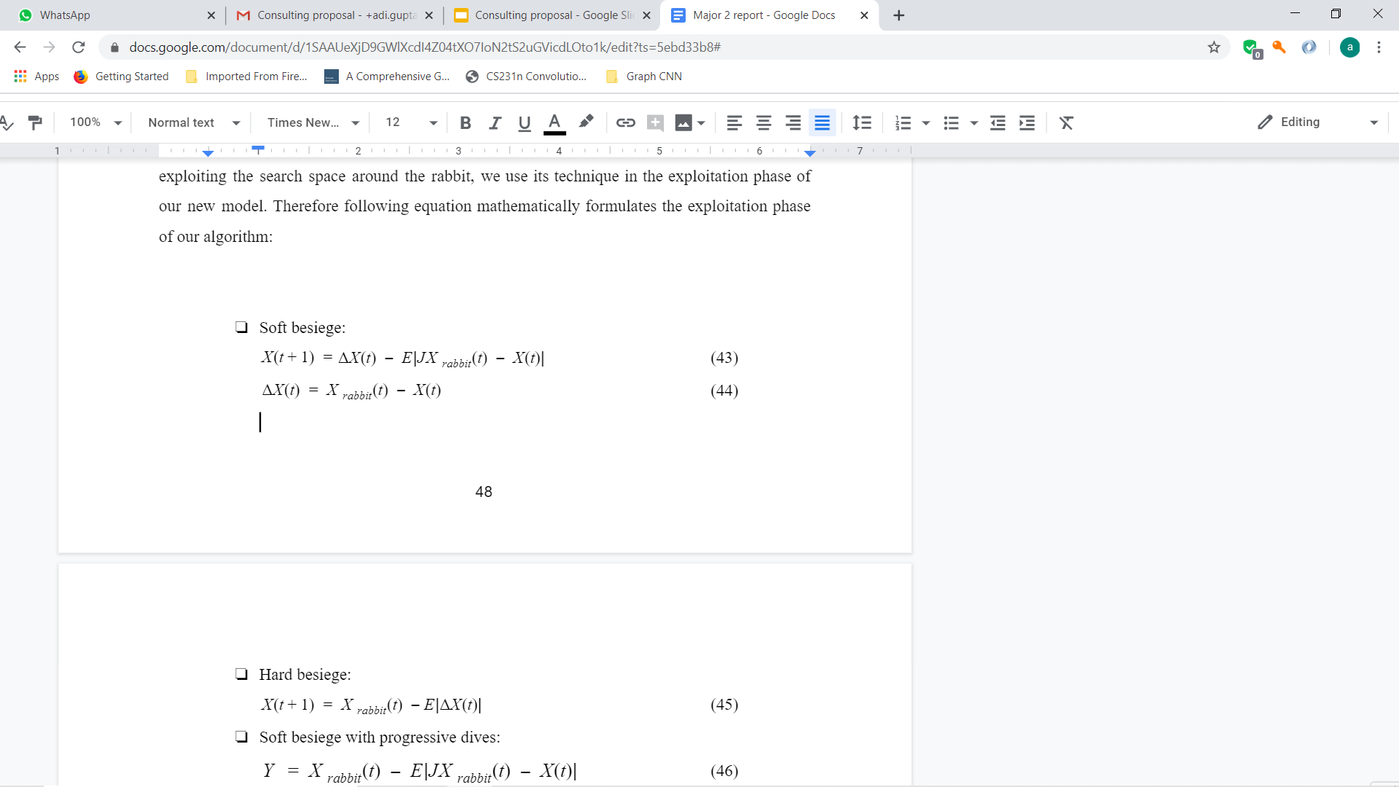
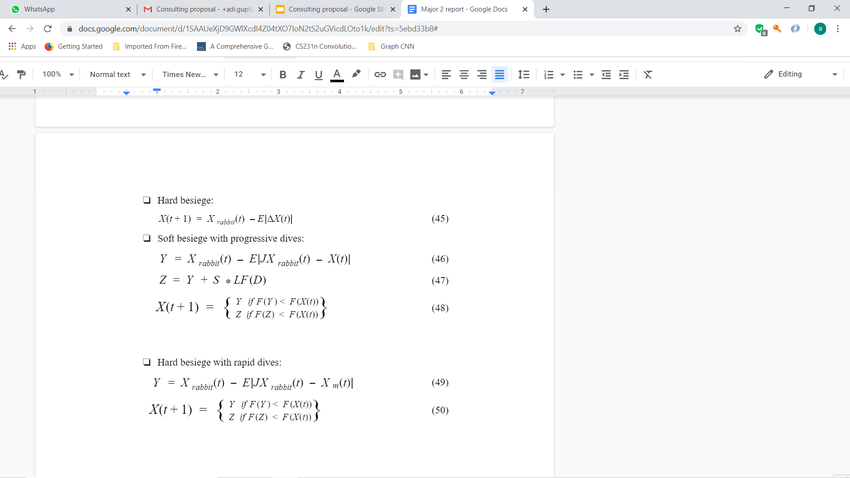
Exploration Phase:
Exploitation Phase:
Exploration and Exploitation Phases
As we have discovered that Harris hawk algorithm is very good in exploiting the search space around the rabbit, we use its technique in the exploitation phase of our new model.
Soft besiege: Hard besiege:

Slide 12
Soft besiege with progressive dives:
Hard besiege with progressive dives:
Exploration and Exploitation Phases

Slide 13
Proposed Algorithm 2
Hybridization of Hawk optimization algorithm and whale optimization algorithm to train weights of Neural Networks

Slide 14
Significance
However the random attacks with Levy flights are so powerful, they lack behind when it comes to avoiding local minima.
Their power to avoid local minima greatly is dependent on the best solution so far and it does not allow the algorithm to explore the search space as freely as it is supposed to for better solutions.
While in Whale Optimization we learn that modifications are done to improve its convergence rate or rather we say it the exploitation behaviour of WOA to improve its results because it has already been proved to be best at avoiding local optima.

Slide 15
Hybridization
The combination of multiple models produced a computationally more intelligent model which improved the performance or we can say avoided poor selection of values for unknown variables by combining the best part of each selected model.
In our model we are going to be dependent on the following parameters:
Energy of the prey(rabbit) E0
jump strength J
Energy E is updated at every iteration as it decreases linearly with time(iterations)
defines the zig-zag random movements(Levy Flights) of the rabbit when hawks close in on him

Slide 16
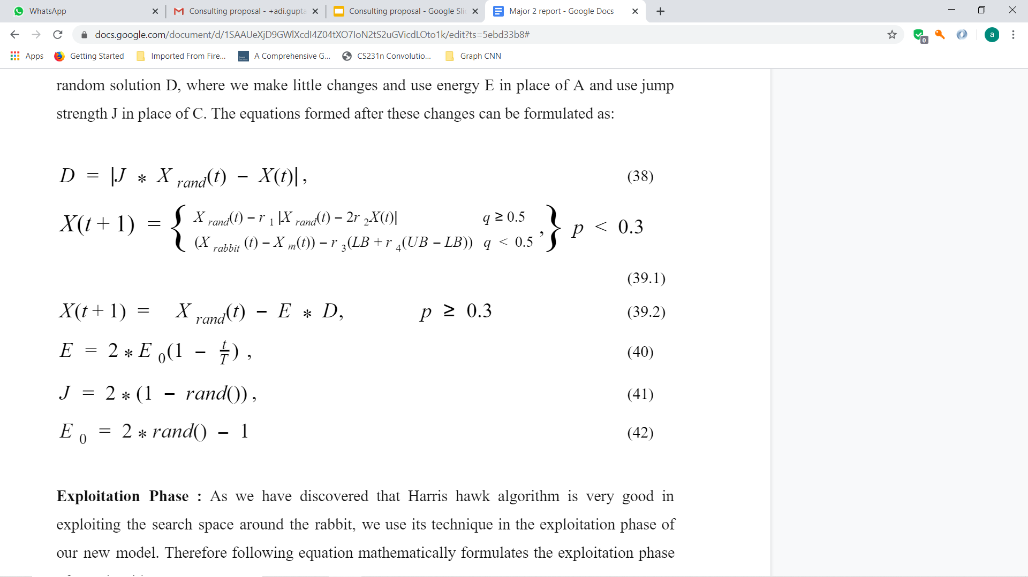
Exploration Phase
The exploration phase of whale optimization algorithm is selected.
This phase is selected most of the times during the initial iterations of the method.

Slide 17
Exploitation Phase
As we have discovered that Harris hawk algorithm is very good in exploiting the search space around the rabbit, we use its technique in the exploitation phase of our new model.
Soft besiege: Hard besiege:
Soft besiege with progressive dives: Hard besiege with progressive dives:

Slide 18
Flowcharts

Slide 19
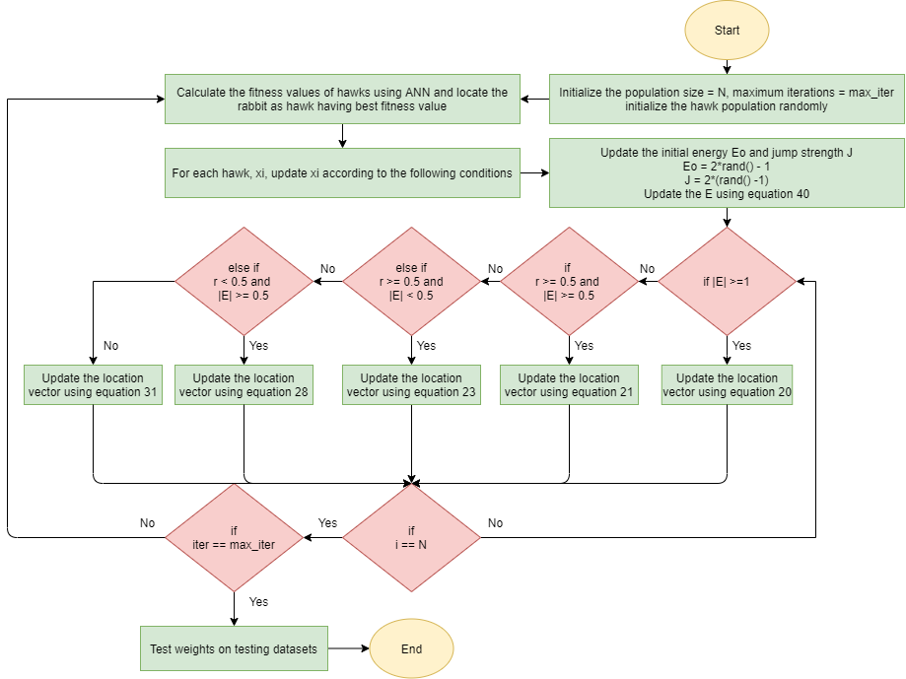
1
Flowchart of Harris hawk optimization algorithm hybridized with neural network

Slide 20
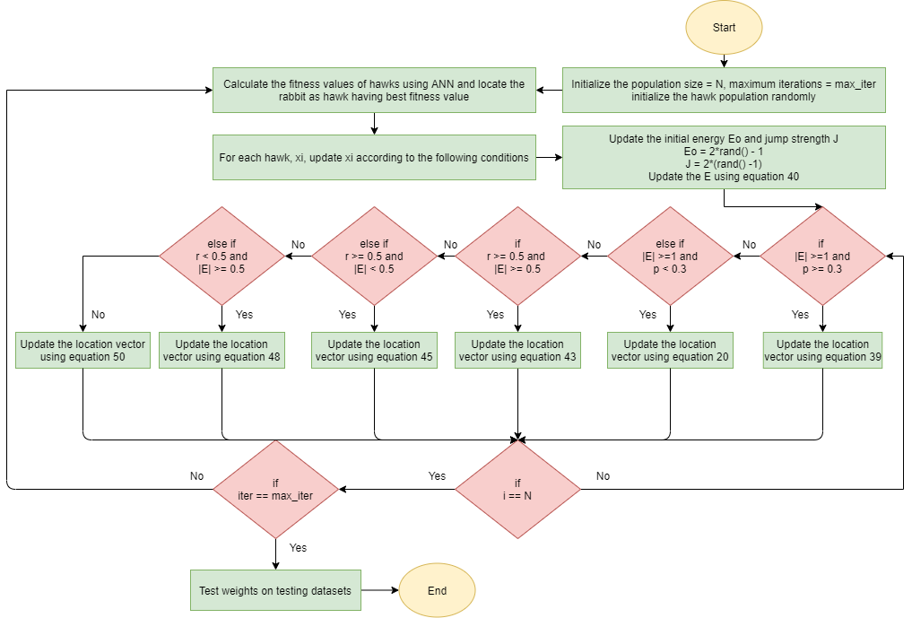
2
Flowchart of Harris hawk optimization algorithm hybridized with whale optimization algorithm to train neural networks.

Slide 21
Inputs: The population size N and maximum number of iterations T. Outputs: Location of the rabbit having best fitness value Initialize the random population X_{i} (i = 1, 2,......., N) Calculate the fitness values of hawks using ANN and locate the rabbit as hawk having best fitness value
while (stopping condition is not met) do: Set Xrabbitas the location of rabbit (best location) for (each hawk (Xi)) do: Update the initial energy E0 and jump strength J E0= 2 * rand ( ) - 1, J= 2 * (1 - rand ( ))
Update the E using Eq. (40) if (|E| ≥ 1) then - Exploration phase Update the location vector using Eq. (20)
if (|E| < 1) then - Exploitation phase if (r ≥ 0.5 and |E| ≥ 0.5 ) then - Soft besiege Update the location vector using Eq. (21) else if (r ≥ 0.5 and |E|<0.5) then - Hard besiege Update the location vector using Eq. (23) else if (r <0.5 and |E|≥ 0.5) then - Soft besiege with Update the location vector using Eq. (28) progressive rapid dives else if (r< 0.5 and |E|< 0.5) then - Hard besiege with Update the location vector using Eq. (31) progressive rapid dives
Calculate the fitness values of hawks using ANN and update the rabbit as hawk having best fitness value
return Xrabbit
Algorithm 1: pseudo code of Harris Hawk Algorithm

Slide 22
Inputs: The population size N and maximum number of iterations T. Outputs: Location of the rabbit having best fitness value Initialize the random population X_{i} (i = 1, 2,......., N) Calculate the fitness values of hawks using ANN and locate the rabbit as hawk having best fitness value
while (stopping condition is not met) do: Set Xrabbitas the location of rabbit (best location) for (each hawk (Xi)) do: Update the initial energy E0 and jump strength J E0= 2 * rand ( ) - 1, J= 2 * (1 - rand ( ))
Initialize p as random value in range(0,1) Update the E using Eq. (40) if (|E| ≥ 1 and p 0.3) then - Exploration phase Update the location vector using Eq. (39) (using WOA exploration eq.)
else if (|E| ≥ 1 and p < 0.3)
Update the location vector using Eq. (20) (using Harris exploration eq.)
else if (|E| < 1) then - Exploitation phase if (r ≥ 0.5 and |E| ≥ 0.5 ) then - Soft besiege Update the location vector using Eq. (43) else if (r ≥ 0.5 and |E|<0.5) then - Hard besiege Update the location vector using Eq. (45) else if (r <0.5 and |E|≥ 0.5) then - Soft besiege with Update the location vector using Eq. (48) progressive rapid dives else if (r< 0.5 and |E|< 0.5) then - Hard besiege with Update the location vector using Eq. (50) progressive rapid dives
Calculate the fitness values of hawks using ANN and update the rabbit as hawk having best fitness value
return Xrabbit
Algorithm 2: pseudo code of Harris Hawk + WOA Algorithm

Slide 23
Results:
The excellence of the proposed algorithm is certified by exercising it on many kinds of datasets of fraud and cancer and these statistical results are compared with the results of rival optimization algorithms. The procured results demonstrate that our proposed algorithm functions better than other evolutionary methods.
Network of the model which straightforwardly influence the accuracy of our model. Therefore, we are showing results of 3 different variations of our network, i.e, i)With one hidden layer , ii)With one hidden layer , iii)With one hidden layer.

Slide 24
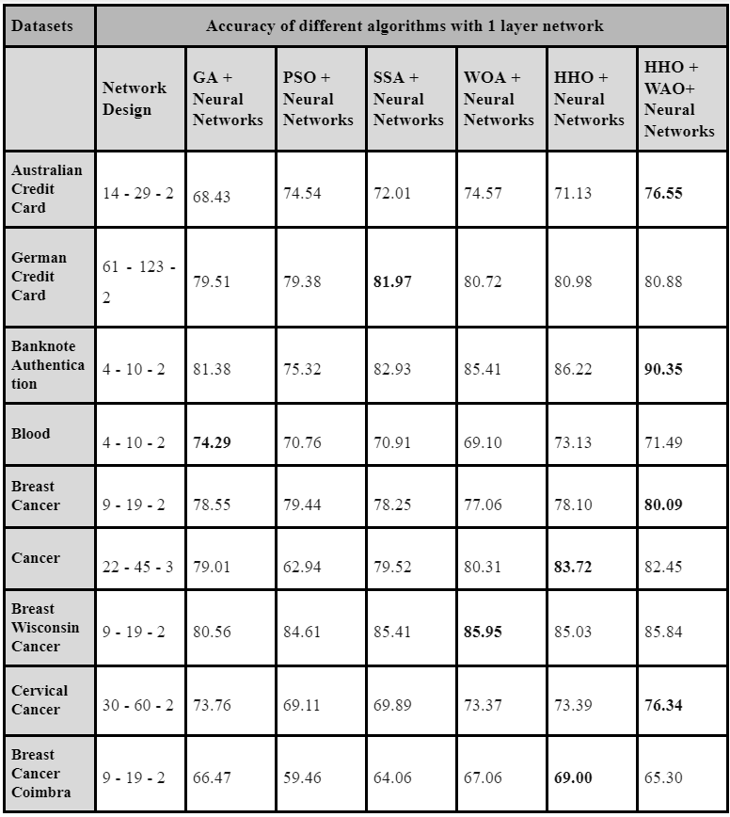
1
Table . Accuracy of algorithms with 1 hidden layer network

Slide 25
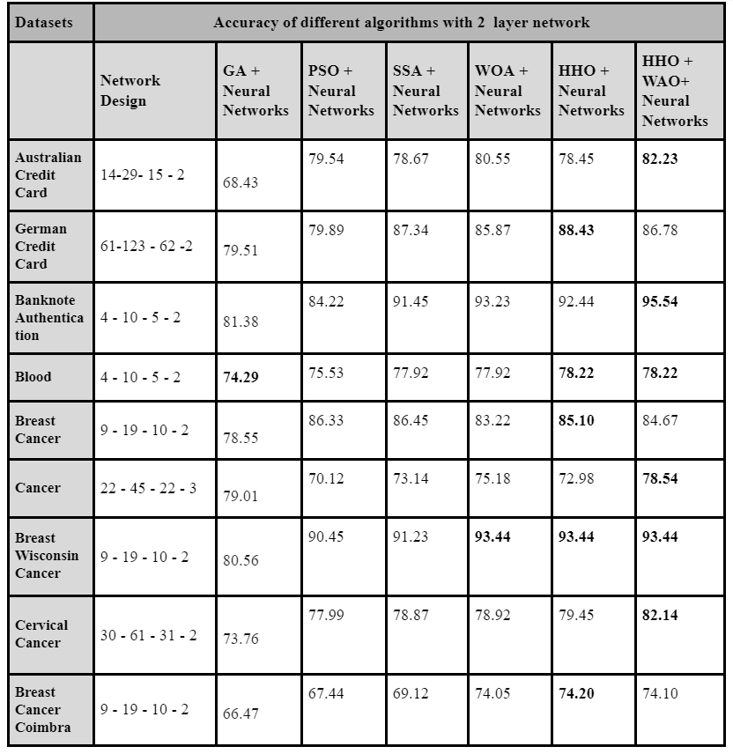
2
Table . Accuracy of algorithms with 2 hidden layer network

Slide 26
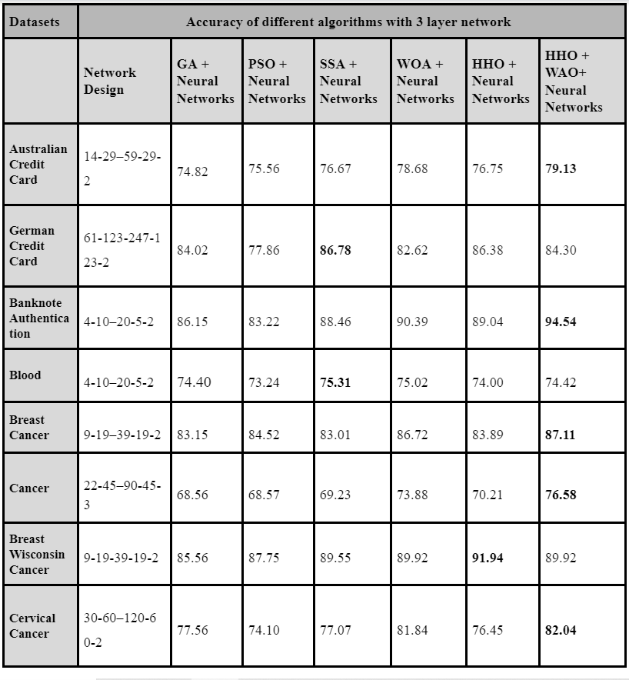
3
Table . Accuracy of algorithms with 3 hidden layer network

Slide 27
Conclusion
We proposed two new algorithms: 1) Harris hawk optimization algorithm to train neural networks and 2) Harris hawk optimization algorithm hybridized with whale optimization algorithm to train weights of neural networks.
We collected ten benchmark datasets from the UCI machine learning repository and tested our algorithms’ performance on them. We compared the results with many other nature inspired algorithms.
The experimental results display the fact that when harris hawk is used to train the weights of neural networks, it significantly improved the quality of solution and further improvement was made by hybridizing it with whale optimization algorithm and used it to train weights.
The comparative study compares the accuracy of our proposed algorithm with other nature inspired algorithms on all datasets and clearly suggests us that using the proposed algorithm will give higher accuracy

Slide 28
Thank you.

